Slide 1
Beyond the Surface: Developing AI Models for Deep Contextual Understanding!
Advisor Professor: Tayara Hilal
201923196 - Pardinov Firdavs
201923250 - Kobilov Ilkhomjon
Team 4

Slide 2
CONTENTS
Things we will cover in this presentation:
Quick review of the last Presentation about Chatbots, NLPs and Machine Learning
Haystack, Huggingface and Roberta QA
Challenges in implementation of Roberta
Code review of Roberta QA in Python
Future expectations from Question-Answering models
Risk related to Machine learning models

Slide 3
01
02
03
ML
NLP
Chatbot
Machine learning algorithgms make the Natural Language Processing possible
Natural Language Processing models will make QA models possible
NLP QA models will make chatbots that are capable of understanding deep contextual data

Slide 4
“Artificial intelligence and chatbots are reshaping the landscape of human-machine interaction, opening up new frontiers of efficiency, convenience, and personalized experiences.”
—Sundar Pichai, CEO of Google

Slide 5
Haystack, Huggingface and Roberta QA
Hugging Face is a company and an open-source community that focuses on developing state-of-the-art natural language processing (NLP) technologies
Robert QA refers to a fine-tuned version of the RoBERTa language model that is specifically trained for the task of question answering

Slide 6
OPEN-SOURCE
Haystack
Transformers
Haystack is an open-source natural language processing (NLP) framework that allows users to build and customize question-answering systems.
Transformers is a type of neural network architecture that has been used for natural language processing tasks such as language translation, question answering, and text summarization.

Slide 7
Challenges in implementation of Roberta
Model size and computational requirements
Training data and fine-tuning
Data preprocessing and tokenization
1
2
3

Slide 8
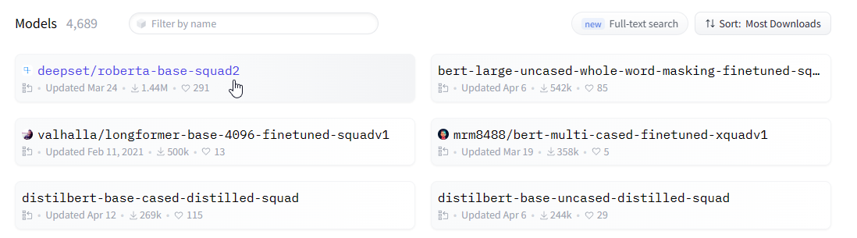
Roberta Base Squad 2
Top model in the Huggingface platform in terms of QA

Slide 9
Code review on building QA model using Haystack
Steps to take for testing simple QA models
Installing Haystack
Initialize Document Store
Prepare the documents
Initialize the retriever
Initialize the reader
Create a Pipeline
Ask a question

Slide 10
Install Haystack
Initialize the Document Store
pip install --upgrade pip
pip install farm-haystack[colab]
from haystack.document_stores import InMemoryDocumentStore
document_store = InMemoryDocumentStore(use_bm25=True)

Slide 11
Prepare the Documents
from haystack.utils import fetch_archive_from_http
doc_dir = "data/build_your_first_question_answering_system"
fetch_archive_from_http(
url="https://s3.eu-central-1.amazonaws.com/deepset.ai-farm-qa/datasets/documents/wiki_gameofthrones_txt1.zip",
output_dir=doc_dir)
import os
from haystack.pipelines.standard_pipelines import TextIndexingPipeline
files_to_index = [doc_dir + "/" + f for f in os.listdir(doc_dir)]
indexing_pipeline = TextIndexingPipeline(document_store)
indexing_pipeline.run_batch(file_paths=files_to_index)

Slide 12
Initialize the Retriever
Initialize the Reader
from haystack.nodes import BM25Retriever
retriever = BM25Retriever(document_store=document_store)
from haystack.nodes import FARMReader
reader =FARMReader(model_name_or_path="deepset/roberta-base-squad2", use_gpu=True)

Slide 13
Create a Pipeline
Ask a question
from haystack.pipelines import ExtractiveQAPipeline
pipe = ExtractiveQAPipeline(reader, retriever)
prediction = pipe.run(
query="Who is the father of Arya Stark?",
params={
"Retriever": {"top_k": 10},
"Reader": {"top_k": 5}
}
)

Slide 14
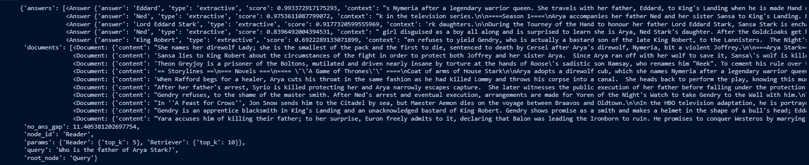
Results

Slide 15
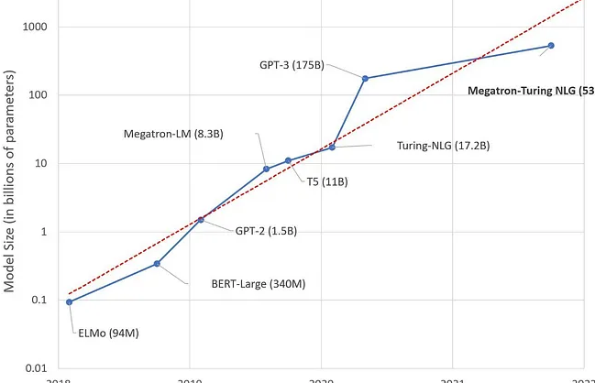
Future expectations from QA Models

Slide 16
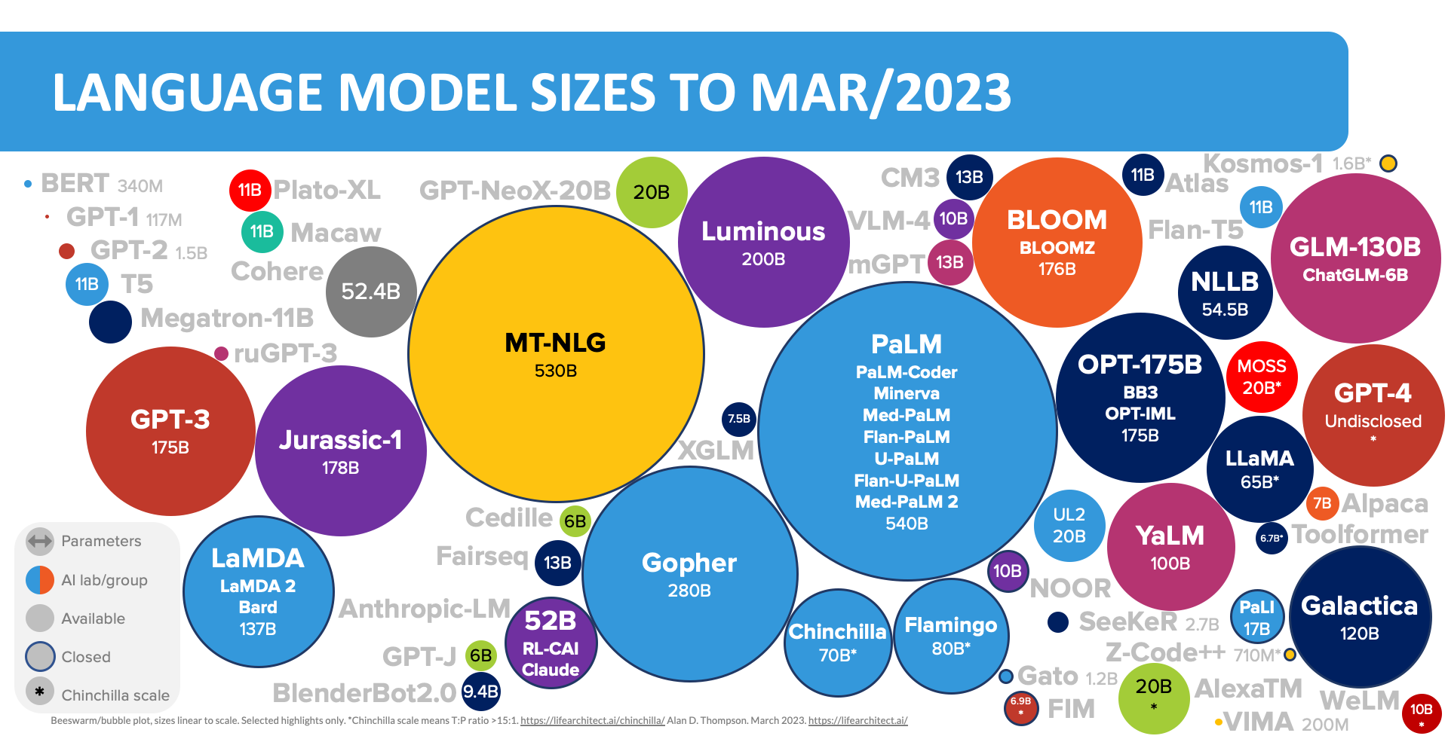

Slide 17
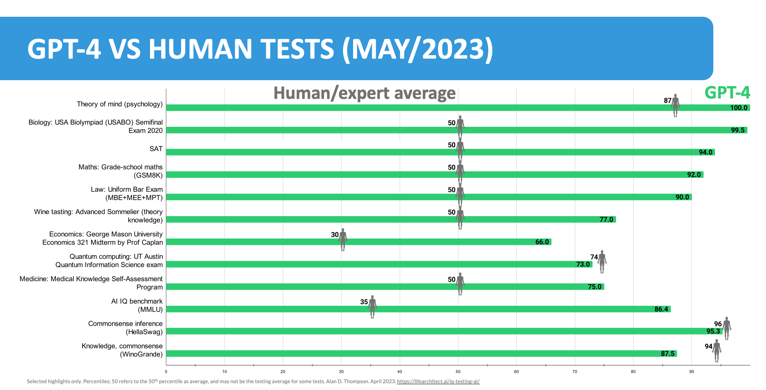

Slide 18
USE CASES of Generative QA Models
Semantic Search System
Information Extractor
Question Answering
Reasoning & Problem solving

Slide 19
Risks of QA models
Innaccurate and misleading information
Job force DROP
Exploitation and vulnerability scanners

Slide 20
THANK YOU!
Questions are welcome

Slide 21
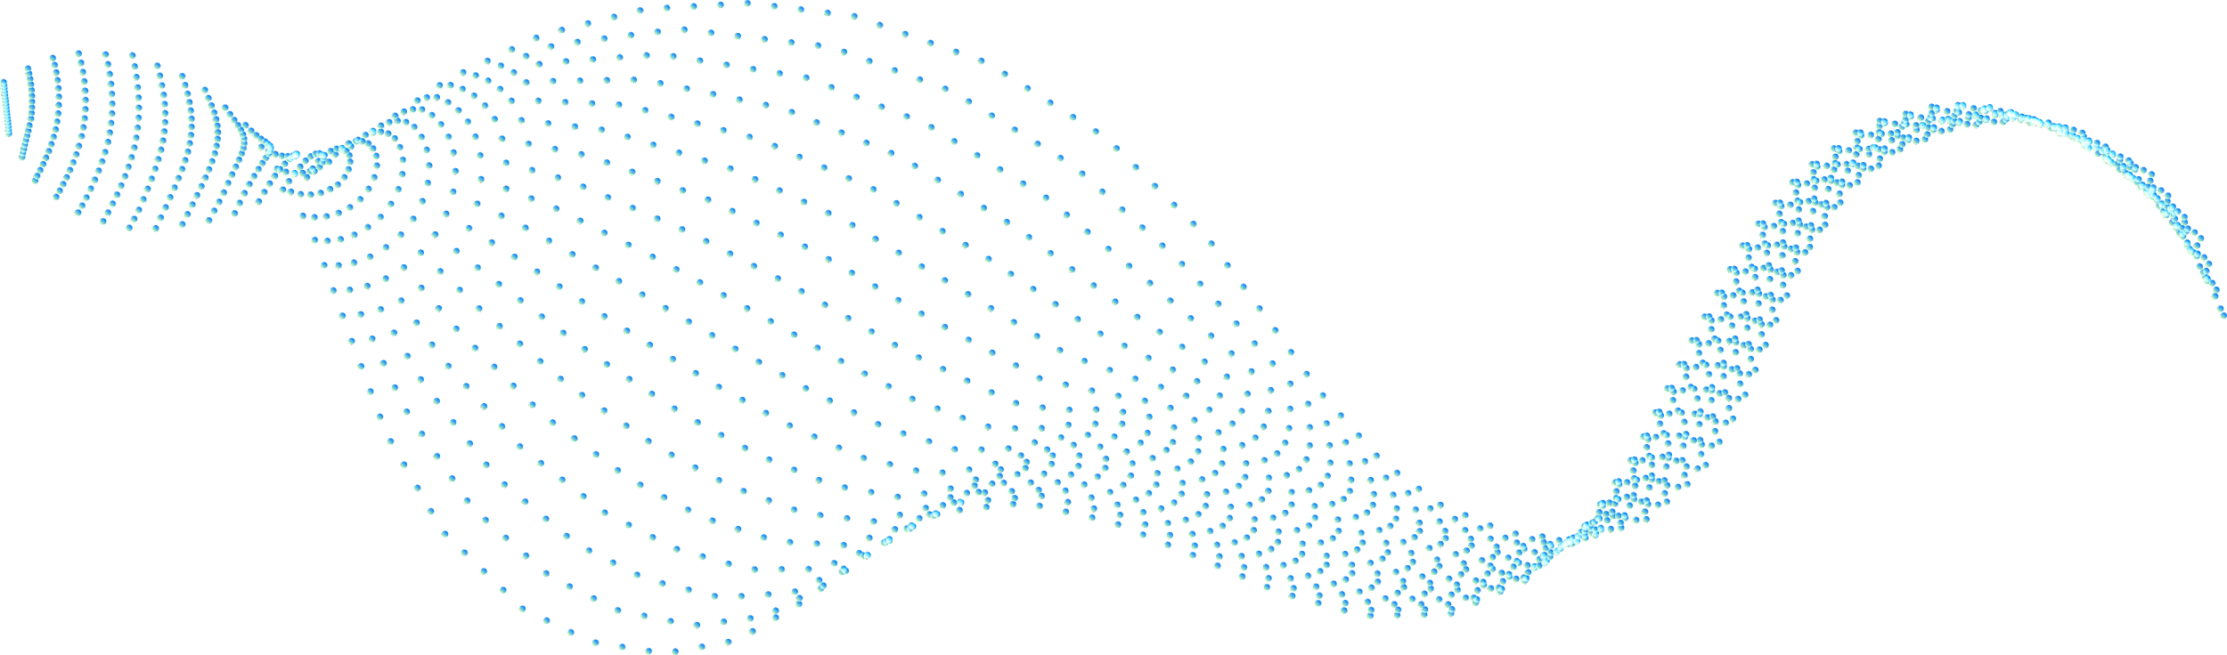



RESOURCES
Links:
Haystack
Huggingface
Deepset

